Slide 1
Machine learning Unit 1 syllabus
Introduction - Well-posed learning problems, designing a learning system, Perspectives and issues in machine learning
Concept learning and the general to specific ordering – introduction, a concept learning task, concept learning as search, find-S: finding a maximally specific hypothesis, version spaces and the candidate elimination algorithm, remarks on version spaces and candidate elimination, inductive bias.
Decision Tree Learning – Introduction, decision tree representation, appropriate problems for decision tree learning, the basic decision tree learning algorithm, hypothesis space search in decision tree learning, inductive bias in decision tree learning, issues in decision tree learning

Slide 2
Well posed Learning Problems
Definition: A computer program is said to learn from experience E with respect to some class of tasks T and performance measure P, if its performance at tasks in T, as measured by P, improves with experience E.
For any problem we must identity three features: the class of tasks, the measure of performance to be improved, and the source of experience
A Checkers learning problem:
- Task T: playing checkers
- Performance measure P: percent of games won against opponents
- Training experience E: playing practice games against itself

Slide 3
A handwriting recognition learning problem:
- Task T: recognizing and classifying handwritten words
within images
- Performance measure P: percent of words correctly
classified
- Training experience E: a database of handwritten
words with given classifications
A robot driving learning problem:
- Task T: driving on public four-lane highways using
vision sensors
- Performance measure P: average distance traveled
before an error
- Training experience E: a sequence of images and steering
commands recorded while observing a human driver

Slide 4
Designing a Learning System
Choosing the Training Experience
Choosing the Target Function
Choosing a Representation for the Target Function
Choosing a Function Approximation Algorithm
The Final Design

Slide 5
1.Choosing the Training Experience
First is to choose the type of training experience from which our system will learn.
- Has significant impact on failure or success of the learner
One key attribute is Whether training experience provides direct or indirect feedback regarding the choices made by the performance system.
Direct feedback - correct move for every step
Indirect feedback- Consisting of move sequences and final outcomes.
-No credit assignment for each move.
-Credit assignment is difficult.
learning is easy from direct feedback.

Slide 6
1.Choosing the Training Experience
Second attribute of training experience is the degree to which the learner controls the sequence of training examples
Learner self learns and ends up with confusion
Novel board states , increases skills
confusion
Ask teacher to help by posing various queries
learner collects training examples by autonomously exploring its environment
learner may have complete control over both the board states and (indirect) training classifications, as it does when it learns by playing against itself with no teacher present.

Slide 7
1.Choosing the Training Experience
A third important attribute of the training experience is how well it represents the distribution of examples over which the final system performance P must be measured
Self learning
No teacher required
is not sufficient
Assumption: Distribution of training is identical to test data

Slide 8
1.Choosing the Training Experience
A checkers learning problem:
Task T: playing checkers
Performance measure P: percent of games won in the world tournament
Training experience E: games played against itself
In order to complete the design of the learning system, we must now choose
1. the exact type of knowledge to be learned
2. a representation for this target knowledge
3. a learning mechanism

Slide 9
2.Choosing the Target Function
The next design choice is to determine exactly what type of knowledge will be learned and how this will be used by the performance program
how to choose the best move from among these legal moves
Program, or function(ChooseMove ), that chooses the best move for any given board state
ChooseMove : B -> M
B:set of legal board states
M: some move from a set of legal moves as output
choice of the target function is key in design
Difficult to choose

Slide 10
2.Choosing the Target Function
An Alternative target function that is easier to choose is
an evaluation function(V) that assigns a numerical score to any given board state
V : B ->R
B: Set of board state, R : set of real numbers
function V assigns higher scores to better board states

Slide 11
2.Choosing the Target Function
Let us therefore define the target value V(b) for an arbitrary board state b in B, as follows:
1. if b is a final board state that is won, then V(b) = 100
2. if b is a final board state that is lost, then V(b) = -100
3. if b is a final board state that is drawn, then V(b) = 0
4. if b is a not a final state in the game, then V(b) = V(b’), where b' is the best final board state that can be achieved starting from b and playing optimally until the end of the game (assuming the opponent plays optimally, as well).
Learning an ideal target function(V) is difficult so we do some approximations to target function.
The process of learning the target function is often called function approximation()) )
V : Ideal target function

Slide 12
3.Choosing a Representation for the Target Function
we must choose a representation that the learning program will use to describe the function Ū that it will learn
A large table with a distinct entry for every state
Collection of rules that match against features of state
Quadratic polynomial function of predefined board features
An artificial neural network
More expensive representation more close to ideal target function V , and more training data we require to choose among the hypotheses
let us choose a simple representation for any given board state

Slide 13
3.Choosing a Representation for the Target Function
The function Ū will be calculated as a linear combination of the following board features:
X1: the number of black pieces on the board
X2:the number of red pieces on the board
X3: the number of black kings on the board
X4: the number of red kings on the board
x5: the number of black pieces threatened by red (i.e., which can be captured on red's next turn)
X6: the number of red pieces threatened by black

Slide 14
3.Choosing a Representation for the Target Function
Our learning program will represent (b) as a linear function of the form
where W0 through W6 are numerical coefficients, or weights, to be chosen by the learning algorithm

Slide 15
3.Choosing a Representation for the Target Function
Partial design of a checkers learning program:
Task T: playing checkers
Performance measure P: percent of games won in the world tournament
Training experience E: games played against itself
Target function: V:Board -> R
Target function representation

Slide 16
4.Choosing a Function Approximation Algorithm
Each training example is an ordered pair is of the form(b, V_{train}(b)).
b : specific board state
V_{train}(b) : Training value for b
This is board state b in which black has won the game (note x2 = 0 indicates that red has no remaining pieces)
V_{train}(b) = +100

Slide 17

4.1.ESTIMATING TRAINING VALUES
Easy to assign scores to board states that correspond to the end of the game
Difficult to assign scores to intermediate board states
Despite the ambiguity inherent in estimating training values for intermediate board states, one simple approach has been found to be surprisingly successful
Where V is the learner's current approximation to
V and where Successor(b) denotes the next board state following b for which it is again the program's turn to move

Slide 18

4.2.ADJUSTING THE WEIGHTS
Choosing the weights w_{i} to best fit the set of training examples (b, V_{train}(b)).
Best fit to the training data
Define best hypothesis or set of weights to minimize squared error
If E is small → most probable hypothesis

Slide 19
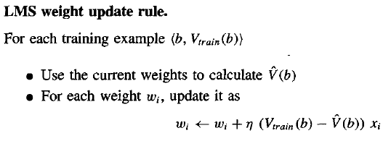
4.2.ADJUSTING THE WEIGHTS
we seek the weights, or equivalently the , that minimize E for the observed training examples.
we require an algorithm that will incrementally refine the
weights as new training examples become available and
that will be robust to errors in these estimated training values
LMS training rule: It adjusts the weights a small amount in the direction that reduces the error on this training example
Here n is a small constant (e.g., 0.1) that moderates the size of the weight update
For each observed training example it adjusts the weights a small amount in the direction that reduces the error on this training example

Slide 20
5.The Final Design
The final design of our checkers learning system can be done by four distinct program modules that represent the central components in many learning systems
Performance System
Solve the task, outputs the game history
Critic
Outputs the set of training examples of the target function.
Generalizer
Outputs the target function hypothesis
Experiment Generator
Outputs a new problem(Board state)

Slide 21
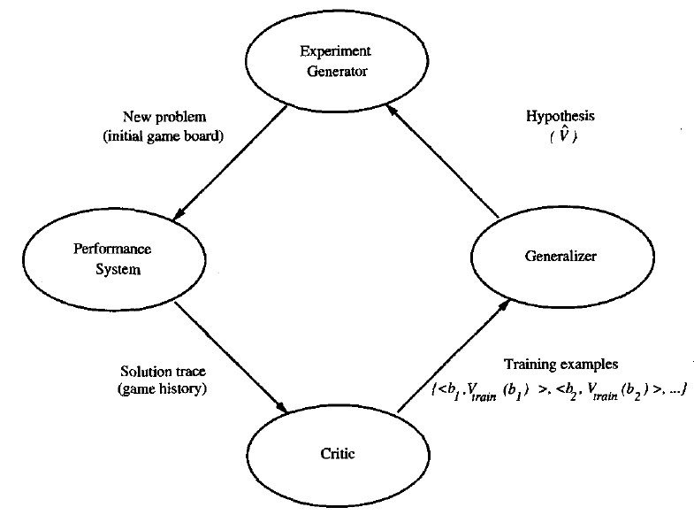
5.The Final Design

Slide 22
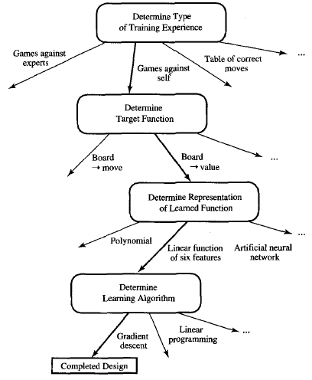
5.The Final Design

Slide 23
Issues in Machine Learning
What algorithms exist for learning general target functions from specific training examples? In what settings will particular algorithms converge to the desired function, given sufficient training data? Which algorithms perform best for which types of problems and representations?
How much training data is sufficient? What general bounds can be found to relate the confidence in learned hypotheses to the amount of training experience and the character of the learner's hypothesis space?
When and how can prior knowledge held by the learner guide the process of generalizing from examples? Can prior knowledge be helpful even when it is only approximately correct?

Slide 24
Issues in Machine Learning
What is the best strategy for choosing a useful next training experience, and how does the choice of this strategy alter the complexity of the learning problem?
What is the best way to reduce the learning task to one or more function approximation problems? Put another way, what specific functions should the system attempt to learn? Can this process itself be automated?
How can the learner automatically alter its representation to improve its ability to represent and learn the target function?

Slide 25
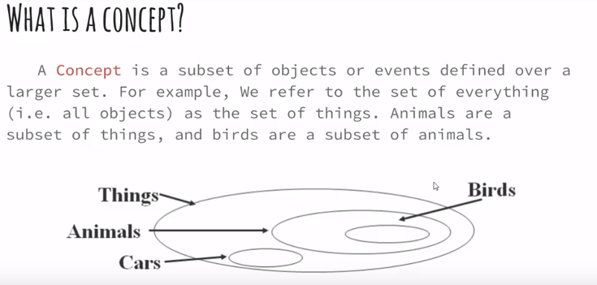
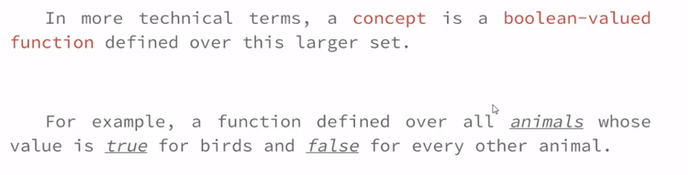

Slide 26
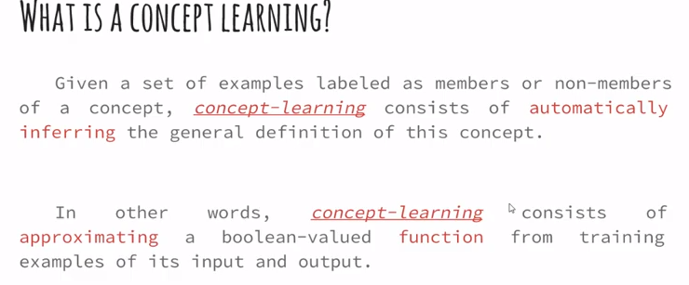

Slide 27
Concept Learning Task
Concept: Good days for WaterSports
Task: to learn to predict the value of EnjoySport for an arbitrary day, based on the values of its other attributes Sky, AirTemp, Humidity, Wind, Water, and Forecast
each hypothesis be a vector of six attributes
Sky, AirTemp, Humidity, Wind, Water, and Forecast
For each attribute, the hypothesis will either
indicate by a "?' that any value is acceptable for this attribute,
specific value (e.g., Warm) for the attribute
indicate by a "Φ" that no value is acceptable.

Slide 28
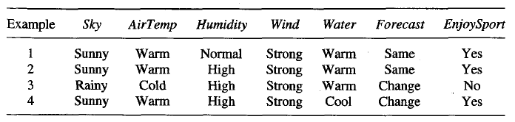

Example of a Concept Learning Task
Example of a hypothesis: If the air temperature is cold
and high humidity high then it is a good day for
water sports.
It can be represented by the expression
According to above training data , given hypothesis is false.
If some instance x satisfies all the constraints of hypothesis
h, then h classifies x as a positive
example h(x) = 1

Slide 29


Concept Learning Task
The most general hypothesis-that every day is a good day for water sports is represented by
(?,?,?,?,?,?)
the most specific possible hypothesis-that no day is a good day for water sports is represented by

Slide 30
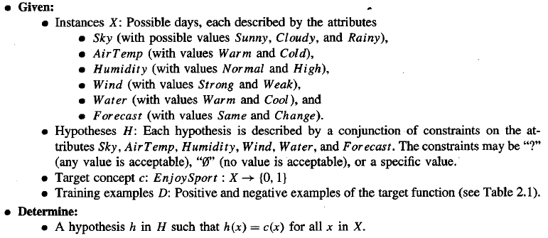
Concept Learning Task
The definition of the EnjoySport concept learning task in this general form is given below

Slide 31
Terminology and Notations
The set of items over which the concept is defined is called a set of instances (denoted b X)
The concept to be learned is called target concept
(denoted by c : X → {0,1} )
A set of training examples is an ordered pair (x, c(x)).
members of the target concept (Instances for which c(x) = 1 ) are called positive examples
nonmembers of the target concept (Instances for which
c(x) = 0) are called negative examples
H represents set of all possible hypotheses. H is designed by human designer’s choice of a hypothesis representation.
The goal of Concept Learning is to find a hypothesis
h : X → {0,1} such that h(x)=c(x) for all x in X.

Slide 32
The Inductive Learning Hypothesis
The learning task is to determine a hypothesis h identical to the target concept c over the entire set of instances X
The inductive learning hypothesis:
Any hypothesis found to approximate the target function well over a sufficiently large set of training examples will also approximate the target function well over other unobserved examples.

Slide 33
CONCEPT LEARNING AS SEARCH
Concept learning can be viewed as the task of searching through a large space of hypotheses implicitly defined by the hypothesis representation
Selecting a hypothesis representation is an is important step since it restricts
(or biases) the space that can be searched.
For Example “If the air temperature is cold or humidity is high then it is a good day for water sports” cannot be represented by our representation
The goal of this search is to find the hypothesis that best fits the training examples
Sky has 3 possible values, and other 5 attributes have 2 possible values .
The instance space X contains exactly 3.2.2.2.2.2 = 96 distinct instances
5.4.4.4.4.4 = 5120 syntactically distinct hypotheses within H
(adding ? and Φ)
Therefore, the number of semantically distinct hypotheses is only
1 + (4.3.3.3.3.3) = 973
Although EnjoySport has small, finite hypothesis space, most learning tasks have much larger (even infinite) hypothesis spaces. – We need efficient search algorithms on the hypothesis spaces

Slide 34

General-to-Specific Ordering of Hypotheses
Many algorithms for concept learning organize the search through the hypothesis space by relying on a general-to-specific ordering of hypotheses.
By taking advantage of this naturally occurring structure over the hypothesis space, we can design learning algorithms that exhaustively search even infinite hypothesis spaces without explicitly enumerating every hypothesis
Consider two hypothesis
Now consider the sets of instances that are classified positive by hl and by h2.
– Because h2 imposes fewer constraints on the instance, it classifies more instances as positive.
– In fact, any instance classified positive by h1 will also be classified positive by h2.
– Therefore, we say that h2 is more general than h1.

Slide 35
General-to-Specific Ordering of Hypotheses
Definition: Let h_{j} and h_{k} be boolean-valued functions defined over X. Then h_{j} is more-general-than-or-equal-to h_{k} (written h_{j} ≥_{g} h_{k}) if and only if
For any instance x in X and hypothesis h in H, we say that x satisfies h if and only if h(x) = 1.
More-General-Than-Or-Equal Relation:
Let h1 and h2 be two boolean-valued functions defined over X.
Then h1 is more-general-than-or-equal-to h2 (written h1 ≥ h2) if
and only if any instance that satisfies h2 also satisfies h1.
h1 is (strictly) more-general-than h2 ( h1 > h2) if and only if h1≥h2 is true and h2≥h1 is false. We also say h2 is more-specific-than h1.
The ≥_{g} , relation defines a partial order over the hypothesis space H (the relation is reflexive, antisymmetric, and transitive

Slide 36
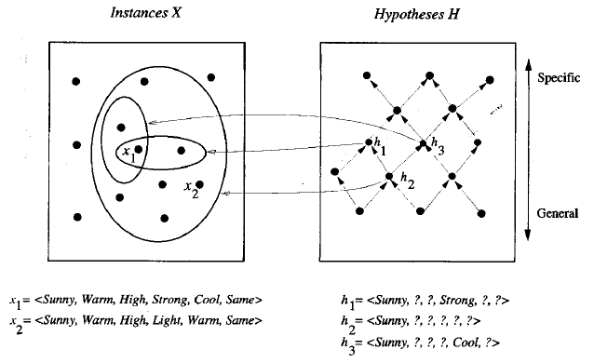
General-to-Specific Ordering of Hypotheses Example
h2 > h1 and h2 > h3
But there is no more-general relation between h1 and h3

Slide 37
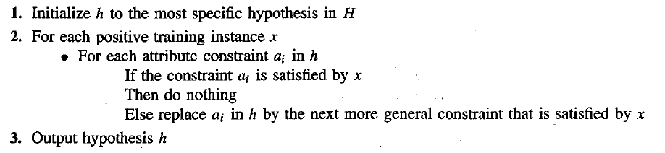
FIND-S: FINDING A MAXIMALLY SPECIFIC HYPOTHESIS ALGORITHM
The FIND-S algorithm illustrates how the “ more-general-than “ partial ordering can be used to organize the search for an acceptable hypothesis.
The search moves from hypothesis to hypothesis , searching from the most specific to progressively more general hypotheses.
At each stage the hypothesis is the most specific hypothesis consistent with the training examples observed up to this point.

Slide 38
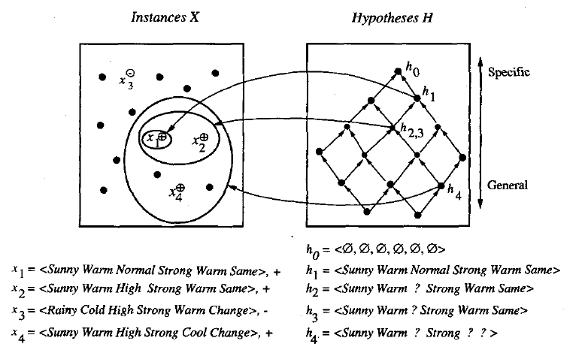

Slide 39
Example

Slide 40
Problems with FIND-S Algorithm:
1. Has the learner converged to the correct target concept?
It cannot determine if it has learnt the concept. There might be several other hypotheses that match as well – has it found the only one?
2. Why prefer the most specific hypothesis?
Some other hypothesis might be more useful.
3. Are the training examples are consistent?
We would like to detect and be tolerant to errors and noise.
4. What if there are several maximally specific consistent hypotheses?
there is no way for Find-S to find them

Slide 41
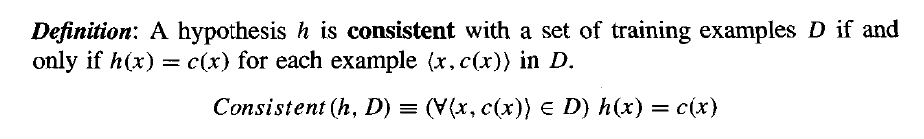
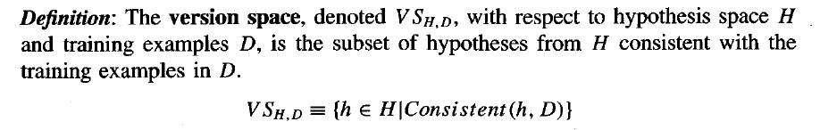
Version Space
Consistency of a hypotheses w.r.t a training dataset
→ Version Space:

Slide 42
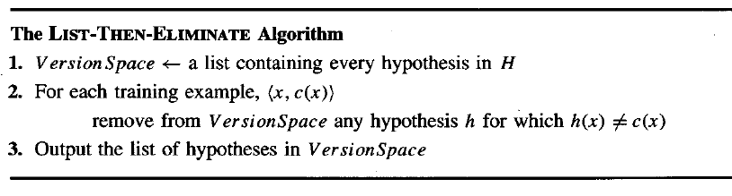
The List-Then-Elimination Algorithm:
This algorithm first initializes the version space to contain all hypotheses in H, Then eliminates any hypothesis found inconsistent with any training example.
Advantage: Guaranteed to output all hypotheses consistent with the training examples.
But inefficient! Even in this simple example, there are 1+4·3·3·3·3 = 973 semantically distinct hypotheses.

Slide 43
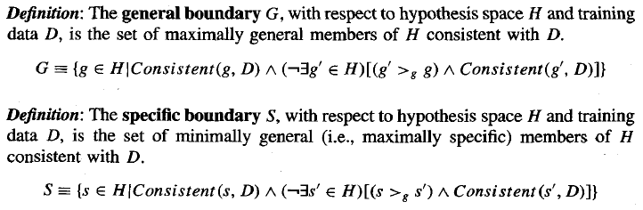
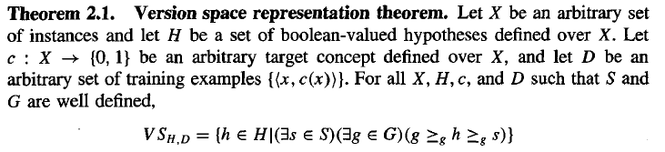
G← maximally general hypothesis in H
S ← maximally specific hypothesis in H
For each training example modify G and S so that G and S are consistent with d

Slide 44
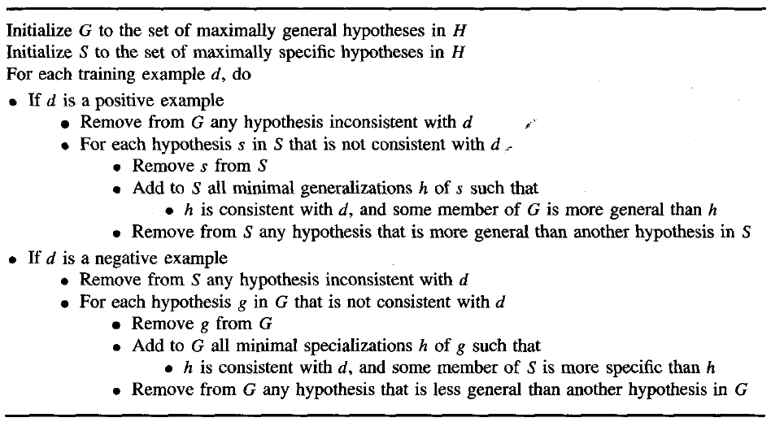
Candidate-Elimination Algorithm:

Slide 45


Candidate-Elimination Algorithm
The Candidate-elimination algorithm computes the version space containing all hypotheses from H that are consistent
initializing the G and S as below, eliminate from the version space any hypotheses found inconsistent

Slide 46
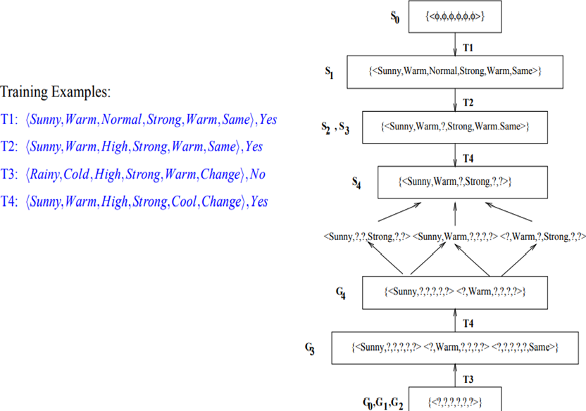

Slide 47
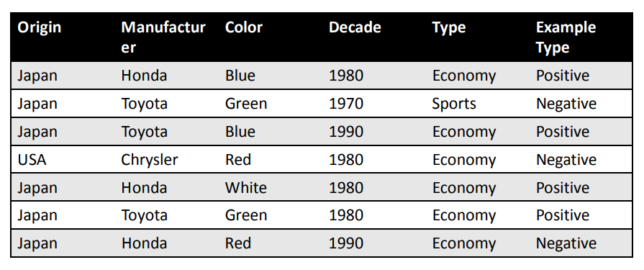

Slide 48
REMARKS ON VERSION SPACES AND CANDIDATE ELIMIATION
Will Candidate-Elimination Algorithm Converge to Correct Hypothesis?
What Training Example Should the Learner Request Next?
How Can Partially Learned Concepts Be Used?

Slide 49
Will Candidate-Elimination Algorithm Converge to Correct Hypothesis?
• The version space learned by the Candidate-Elimination Algorithm will
converge toward the hypothesis that correctly describes the target
concept, provided
– There are no errors in the training examples, and
– there is some hypothesis in H that correctly describes the target concept.
• What will happen if the training data contains errors?
– The algorithm removes the correct target concept from the version space.
– S and G boundary sets eventually converge to an empty version space if sufficient
additional training data is available.
– Such an empty version space indicates that there is no hypothesis in H consistent with all observed training examples.
• A similar symptom will appear when the training examples are correct,
but the target concept cannot be described in the hypothesis
representation.
– e.g., if the target concept is a disjunction of feature attributes and the hypothesis space supports only conjunctive descriptions

Slide 50
What Training Example Should the Learner Request Next?
• Convergence can be speeded up by presenting the data in a strategic order. The best examples are those that satisfy exactly half of the hypotheses in the current version space.
– E.g. T5: {Sunny,Warm,Normal,Light,Warm,Same} satisfies 3 hypotheses in previous example
∗ If T5 positive, S generalised, 3 hypotheses eliminated
∗ If T5 negative, G specialised, 3 hypotheses eliminated
– Optimal query strategy is to request examples that exactly split version space
– converge in ⌈log₂|V S|⌉ steps. However, this is not always possible

Slide 51
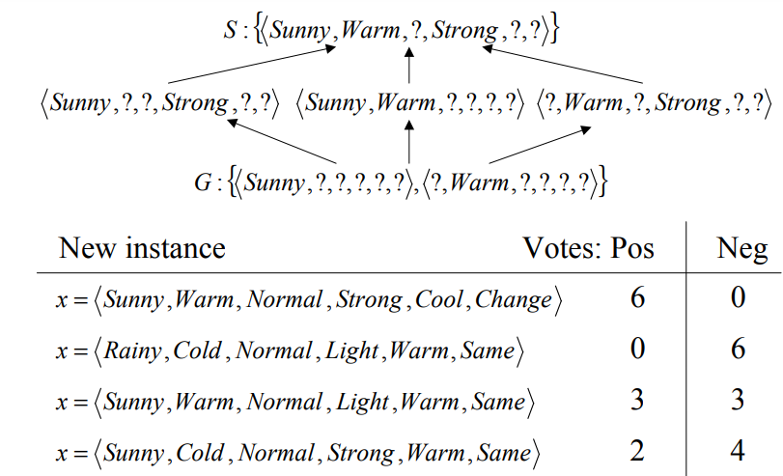
Using Partially Learned Concepts
Version-Spaces can be used to assign certainty scores to the classification of new examples. Voting provides the most probable classification of the new instance

Slide 52
INDUCTIVE BIAS - Fundamental Questions for Inductive Inference
The Candidate-Elimination Algorithm will converge toward the true
target concept provided it is given accurate training examples and
provided its initial hypothesis space contains the target concept.
• What if the target concept is not contained in the hypothesis space?
• Can we avoid this difficulty by using a hypothesis space that includes every possible hypothesis?
• How does the size of this hypothesis space influence the ability of the algorithm to generalize to unobserved instances?
• How does the size of the hypothesis space influence the number of
training examples that must be observed?

Slide 53
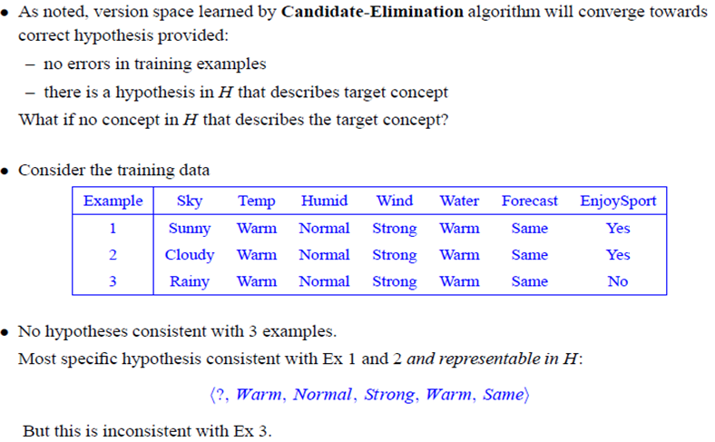
Inductive Bias -A Biased Hypothesis Space
PROBLEM: We have biased the learner to consider only conjunctive hypotheses. We require a more expressive hypothesis space.

Slide 54
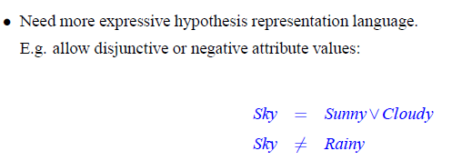

Slide 55
An Unbiased Learner
The obvious solution to the problem of assuring that the target concept
is in the hypothesis space H is to provide a hypothesis space capable of
representing every teachable concept.
– Every possible subset of the instances X -> the power set of X.
What is the size of the hypothesis space H (the power set of X) ?
– In EnjoySport, the size of the instance space X is 96.
– The size of the power set of X is 2^{|X|} -> The size of H is 296
– Our conjunctive hypothesis space is able to represent only 973of these hypotheses.
-> a very biased hypothesis space
Let the hypothesis space H to be the power set of X.
– A hypothesis can be represented with disjunctions, conjunctions, and negations of our earlier hypotheses.
– The target concept "Sky = Sunny or Sky = Cloudy" could then be described as
<Sunny, ?, ?, ?, ?, ?>  <Cloudy, ?, ?, ?, ?, ?>

Slide 56
An Unbiased Learner
NEW PROBLEM: our concept learning algorithm is now completely unable to generalize beyond the observed examples.
– three positive examples (xl,x2,x3) and two negative examples (x4,x5) to the learner.
– S : { x1 V x2 V x3 } and G : { not (x4 V x5) }
-> NO GENERALIZATION
– Therefore, the only examples that will be unambiguously classified by S and G are the observed training examples themselves.

Slide 57
Inductive Bias – Fundamental Property of Inductive Inference
A learner that makes no a priori assumptions regarding the identity
of the target concept has no rational basis for classifying any unseen
instances.
• Inductive Leap: A learner should be able to generalize training data
using prior assumptions in order to classify unseen instances.
• The generalization is known as inductive leap and our prior
assumptions are the inductive bias of the learner.
• Inductive Bias (prior assumptions) of Candidate-Elimination Algorithm s that the target concept can be represented by a conjunction of attribute values, the target concept is contained in the hypothesis space and training examples are correct.

Slide 58
Inductive Bias: Consider a concept learning algorithm L for the set of instances X. Let c be an arbitrary concept defined over X, and let Dc = {<x , c(x)>} be an arbitrary set of training examples of c. Let L(xi, Dc) denote the classification assigned to the instance xi by L after training on the data Dc. The inductive bias of L is any minimal set of assertions B such that for any target concept c and corresponding training examples Dc the following formula holds.
the notation y |- z indicates that z follows deductively from y (i.e., that z
is provable from y). Thus, we define the inductive bias of a learner as the set of additional assumptions B sufficient to justify its inductive inferences as deductive inferences.

Slide 59
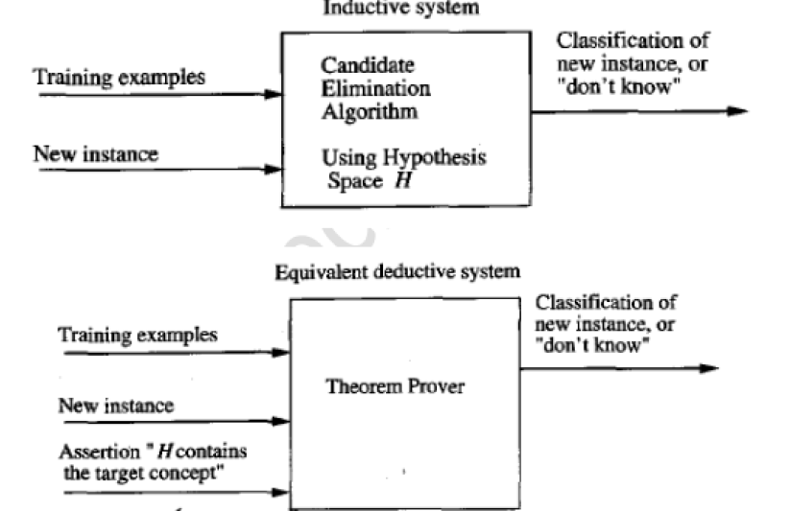

Slide 60
Inductive Bias – Three Learning Algorithms
ROTE-LEARNER: Learning corresponds simply to storing each observed training
example in memory. Subsequent instances are classified by looking them up in
memory. If the instance is found in memory, the stored classification is returned.
Otherwise, the system refuses to classify the new instance.
Inductive Bias: No inductive bias
CANDIDATE-ELIMINATION: New instances are classified only in the case where all
members of the current version space agree on the classification. Otherwise, the
system refuses to classify the new instance.
Inductive Bias: the target concept can be represented in its hypothesis space.
FIND-S: This algorithm, described earlier, finds the most specific hypothesis consistent
with the training examples. It then uses this hypothesis to classify all subsequent
instances.
Inductive Bias: the target concept can be represented in its hypothesis space, and all
instances are negative instances unless the opposite is entailed by its other knowledge.

